Slide 1
Job Salary Prediction
Submitted by
Vinod kumar
Sindhu Muni Padmanabha - 300297872

Slide 2
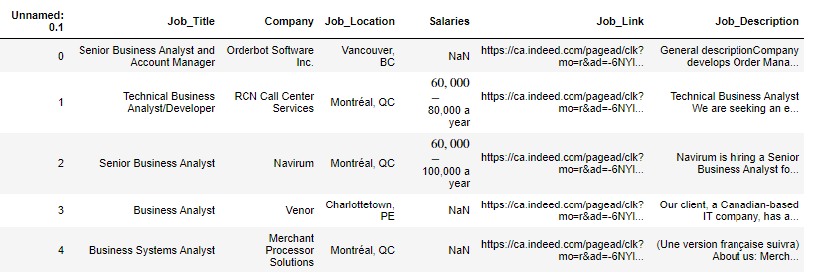
Overview:
This Project is designed for Jobseekers who wants to predict and negotiate the salary with the employer based on the Job description/ Qualifications/ Skills.
The data for performing prediction analysis was scrapped from Indeed with Job title, location, link, description, company and salaries as features.
Scrapped Data

Slide 3
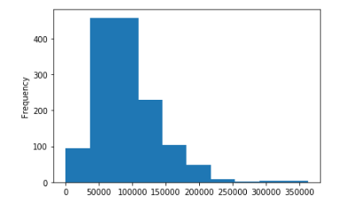
Overview contd.,
We choose Job description and salaries as the required features for analysis.
We used TFID Vectorizer and Word2Vec algorithms for converting text to vectors along with classification methods to predict the salary.
Based on the accuracy results TFID Vectorizer with Random Forest classifier gave us the best accuracy among all. So we used them for predicting the salary.
The frequency of salaries from scrapped data

Slide 4
Models Used:

Slide 5
Learnings:

Slide 6
Limitations:
Data with salaries mentioned in Indeed is limited because of which we got less data with salary information to train and test which affected the accuracy of the model.

Slide 7
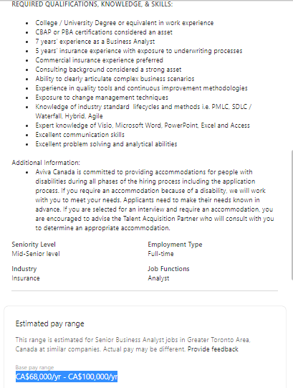
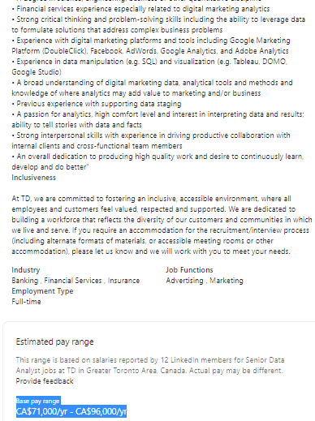
Predictions:
Source: LinkedIn

Slide 8
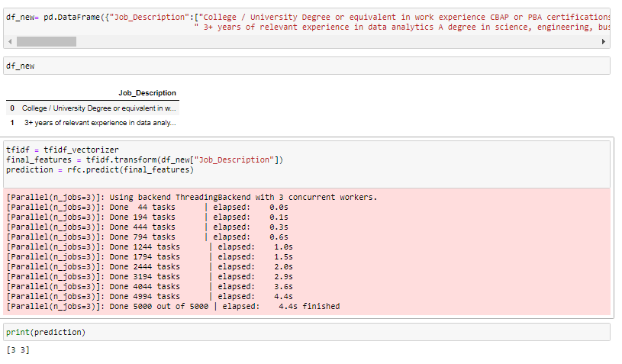
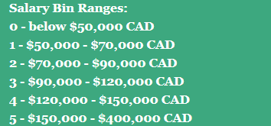
Prediction contd.,
Prediction results:

